Slide 1
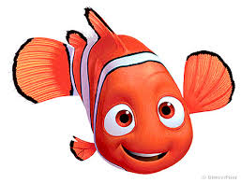
Finding Nemo
Counting Stories Project
By: Sara Ives

Slide 2
Introduction
Through this presentation you will be able to relive the story of Nemo and his adventures while learning some of the basic math found in the grade 12 data management course. Learning the content in this format will help you to see where the math (that everyone thinks they will never use again) can actually be applied. Math questions are incorporated right into the story and the answers are found under the blue boxes. Go at your own speed and HAVE FUN!

Slide 3
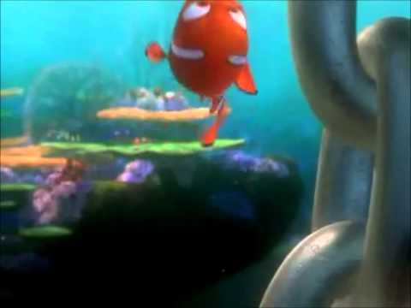
The story begins with a clown fish named Marlin and his son named Nemo. After a close to death encounter when Nemo was an egg, Marlin is very protective of Nemo. While on a field trip with his class Nemo swims a little too far and goes to touch the bottom of a boat.

Slide 4
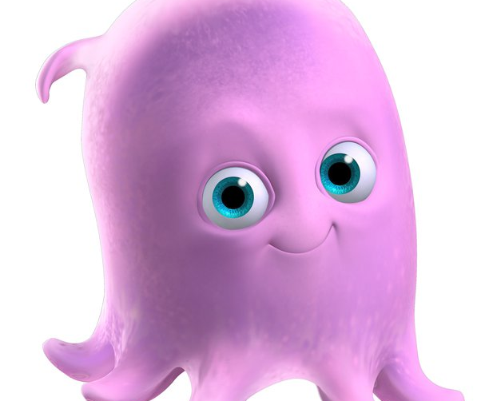
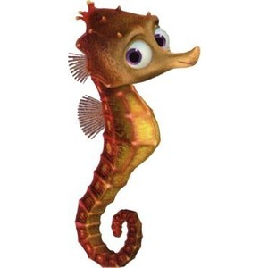
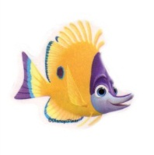
If Nemo’s friends are encouraging him to touch the boat, how many different arrangements of their encouraging shouts can be heard? Each friend can only shout once in an arrangement and only three shouts per arrangement.

Slide 5

ANSWER:
Using Permutations:
P(3,3)
= 3! / (3-3)!
= 3!
= 6
Therefore, there are 6 arrangements of encouraging shouts that can be produced.
Between the encouraging shouts and the thought of disobeying his father, Nemo touches the bottom of the boat and begins to swim back to his friends.
Move the blue box for answer
Slide Blue square away to reveal answer

Slide 6
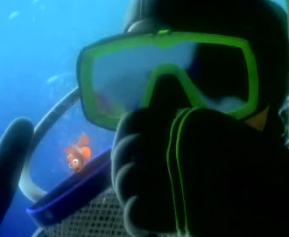
While Nemo is swimming back to safety he is caught by a diver.
The theoretical probability of Nemo getting away is not in his favour.
There are 650 holes in the net in total and 300 are way too small for Nemo, 25 holes are big enough to let him through and the rest of the holes will cause damage to Nemo if he tries to get through. What is the probability that Nemo will get away without any harm?

Slide 7
ANSWER:
There are 650 holes in the net in total and 300 are way to small for Nemo, 25 holes are big enough to let him through and the rest of the holes will cause damage to Nemo if he tries to get through. What is the probability that Nemo will get away without any harm?
Move blue box for answer
Probability that he escapes:
= 25 holes big enough/650 total holes
= 1/26
Therefore, the probability that Nemo will escape from the diver’s net is 1/26.
Holes that will damage: 650-325= 325
300 holes can not be used and if Nemo can not be harmed while escaping than another 325 can’t be used either.

Slide 8
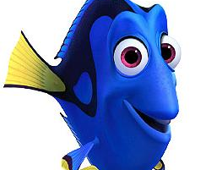
After Nemo gets taken, Marlin chases after him to save him. He loses the boat that Nemo got taken in and accidentally runs into Dory.
Finding Dory could be determined using conditional probability. Dory was accidentally hit by Marlin out of a large school of fish what was the conditional probability of that?

Slide 9
Question and ANSWER:
Using the below chart, what would be the conditional probability of finding Dory?
P(the fish is blue/female)
Gender | Yellow | Green | Brown | Blue
Males | 5 | 7 | 4 | 9
Females | 7 | 3 | 8 | 1
P(the fish is blue/female)
= 1/19
Therefore, using the chart the conditional probability of finding Dory was 1/19 fish.
Move blue box for answer

Slide 10
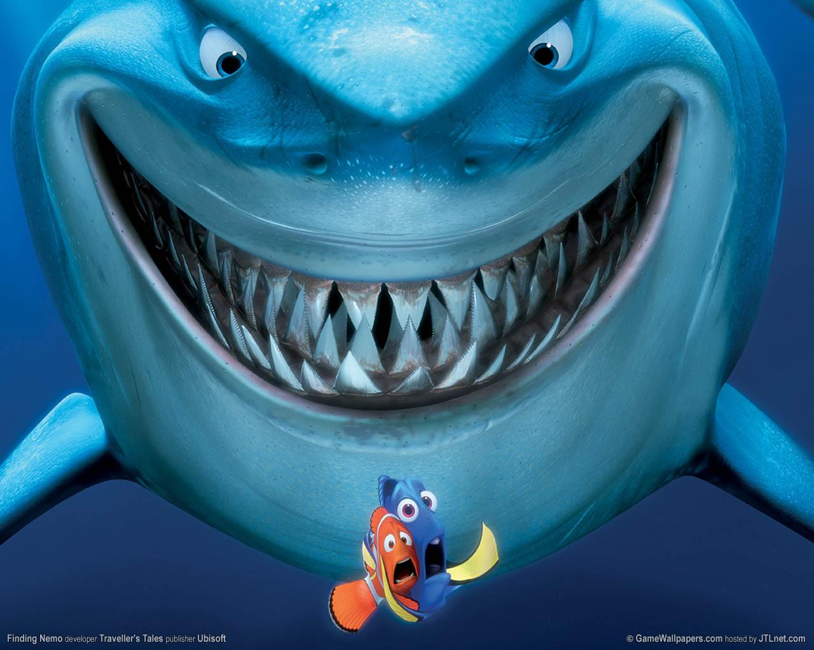
After meeting Dory they become partners in the hunt to find Nemo. After a little break they run into a great white shark named Bruce. The shark invites Dory and Marlin to his shark party. The two friends can’t decide if they should go or not so to decide they flip a sand dollar 10 times.

Slide 11
Coin Flip | Result
1 | heads
2 | tails
3 | tails
4 | heads
5 | heads
6 | heads
7 | tails
8 | heads
9 | tails
10 | tails
Through the experiment, the fish hoped to come to a definitive yes or no to go to the party or not. They had decided ahead of time that if they got a head that was a yes and a tail meant no.
Head= they should go
Tail= they shouldn’t go
As it can be seen here after the first trial of the experiment there was a tie in yes and no answers. Due to this, Marlin and Dory decided to do one more trial.
Trials are the number of repetitions of an experiment.

Slide 12
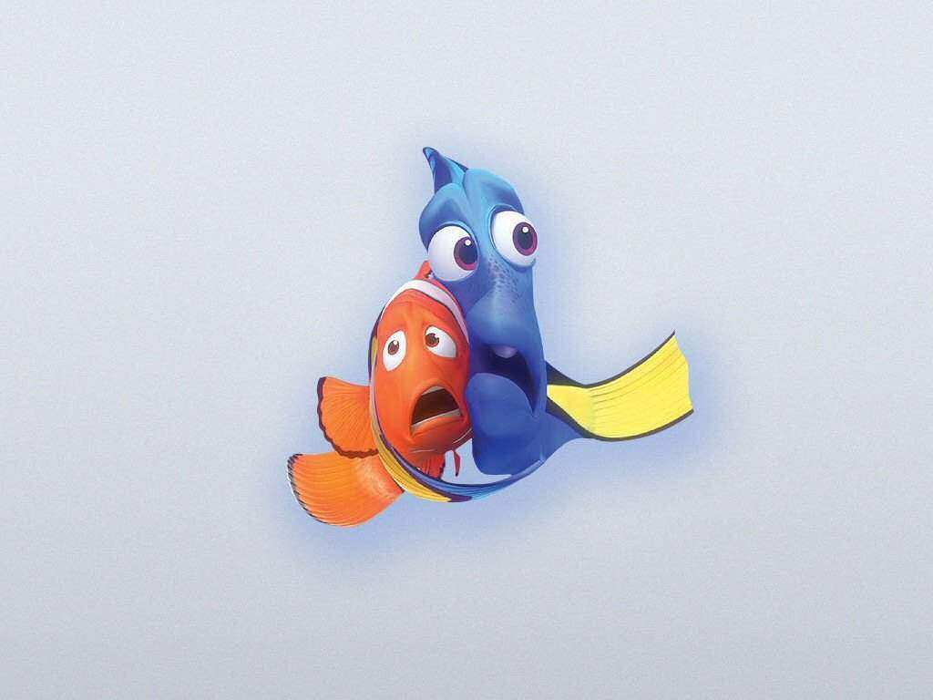
Trial #2
Coin Flip | Result
1 | heads
2 | tails
3 | tails
4 | tails
5 | heads
6 | heads
7 | heads
8 | tails
9 | heads
10 | heads
Second Trial:
Heads= 6
Tails= 4
Therefore, since they got six heads which are yes’s, they proceed to go to the shark party.
Move blue box to see results and conclusion from second trial

Slide 13
Out of Marlin and Dory, Marlin was the fish least excited about going to the shark party. After using the experiment to determine that the two should go to the shark party, Marlin was curious as to what was the experimental probability that they wouldn’t have gone to the party.
Move blue box for answer
ANSWER:
Using the previous information given the experimental probability can be determined easily.
Not going= tails
Total # of flips=20
Probability of not going to party= tails/ total flips
= 9/20
Therefore, the experimental probability of not going is 9/20.

Slide 14

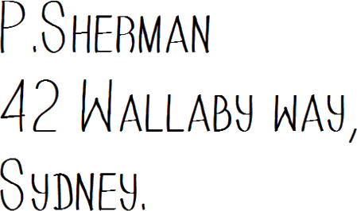
After escaping from the shark party Marlin and Dory find goggles that were worn by one of the humans when Nemo was taken. There was an address written on the band. Dory slowly reads the adress and they are on their way.

Slide 15
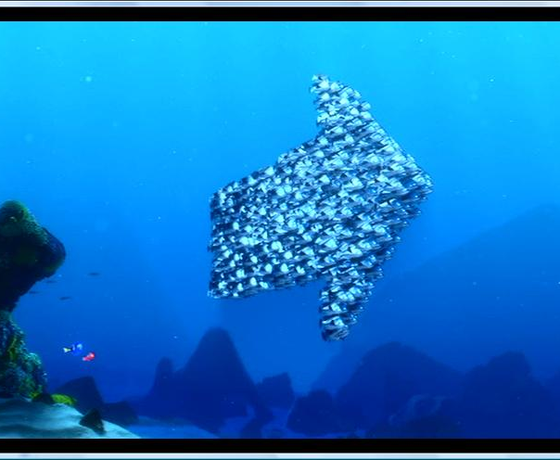
After swimming for a bit they realize that they don’t know where they are going so they ask a group of fish for directions.
To get the proper direction from the fish they tell Marlin and Dory that they have to swim through a maze that they build using themselves.

Slide 16
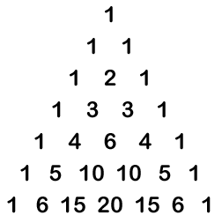
Question and ANSWER:
If the maze that the group of fish set up is in the form of Pascal’s Triangle, what is the total number of ways (paths) that Marlin and Dory can get through the fish?
To find the total number of paths, all that has to be done is add the numbers of the bottom row together.
1+6+15+20+15+6+1=64
Therefore, there are 64 ways that Marlin and Dory can get through the group of fish.
Move blue box to see answer

Slide 17
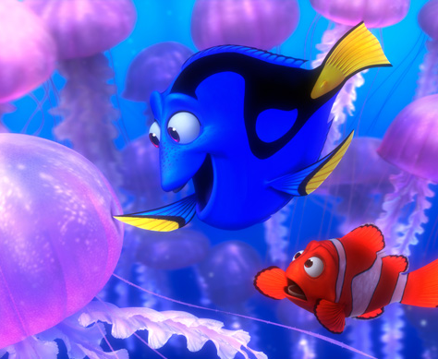
Once through the group of fish, they tell Marlin and Dory to head through a gully and towards the EAC (East Australian Current). Instead of following what the fish said, Marlin and Dory go over the gully instead of through it and find themselves in a field of jellyfish.

Slide 18
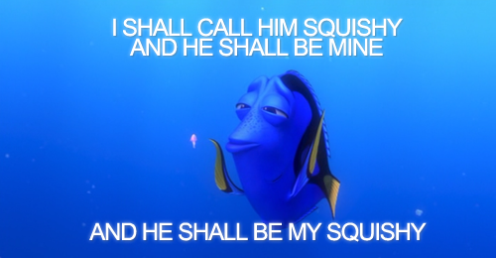
Outcomes are described as what could happen in the end. If Marlin and Dory are travelling through this field of jellyfish, what is the total number of outcomes if the following situations could occur?
-Marlin and Dory make it through without injury
-Marlin is okay but Dory gets hurt
-Dory is okay but Marlin gets hurt
-Both Dory and Marlin get hurt
-Both Dory and Marlin get lost in the field of jellyfish

Slide 19
ANSWER:
What is being asked?
The total number of possible outcomes
What are we given?
The possible occurrences
-Marlin and Dory make it through without injury
-Marlin is okay but Dory gets hurt
-Dory is okay but Marlin gets hurt
-Both Dory and Marlin get hurt
-Both Dory and Marlin get lost in the field of jellyfish
To find number of total possible outcomes = 5
All that had to be done was add all the outcomes together.
Therefore, there are 5 possible outcomes.
Move blue box for answer

Slide 20
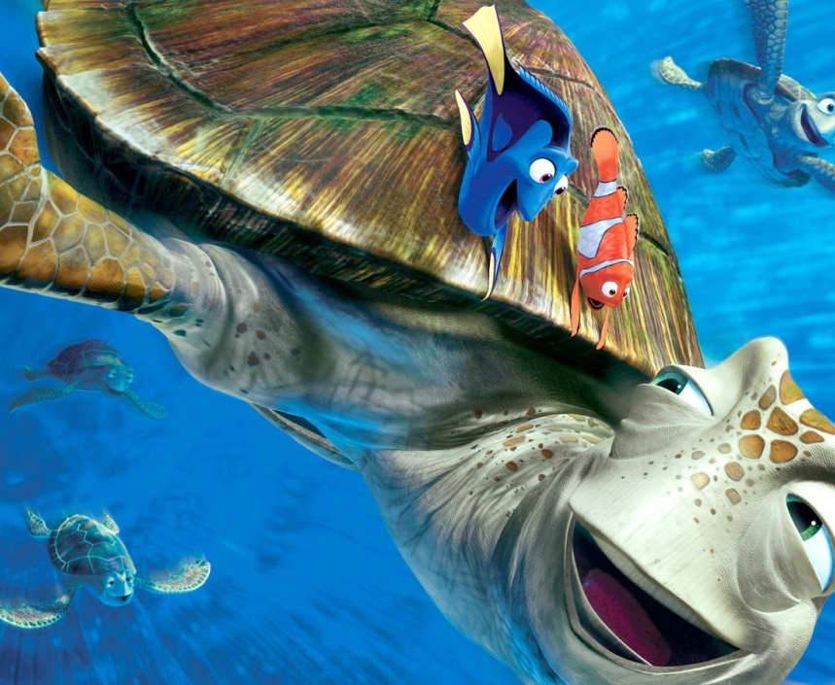
When Marlin and Dory get through the jellyfish, both have been injured and swept up by some sea turtles. Luckily when the fish awake, they are being carried by the turtles on the EAC which was what they were trying to find.
Crush which was the turtle that found them wanted Marlin and Dory to meet his children Squirt and Wave. However, he was having trouble finding them.

Slide 21
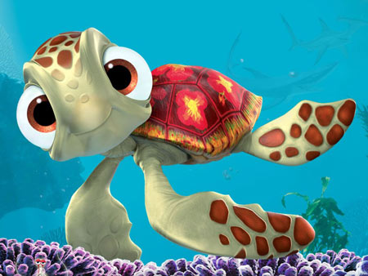
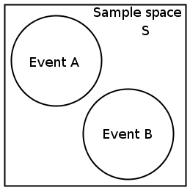
Question and ANSWER:
What is the probability of finding Squirt or Wave if the events are mutually exclusive?
When working with mutually exclusive events use the equation P(AuB)=P(A)+P(B)
If the probability of finding Squirt (A) is 0.25 and the probability of finding Wave(B) is o.125 what is P(AuB)?
Mutually exclusive means that there will be no ‘overlap’. In this case, this means that Wave and Squirt won’t both be found, only one will be found.
Move box for answer
P(AuB)=P(A)+P(B)
= 0.25+0.125
=0.375
Therefore, the probability of finding Wave or Squirt is 0.375.

Slide 22
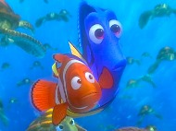
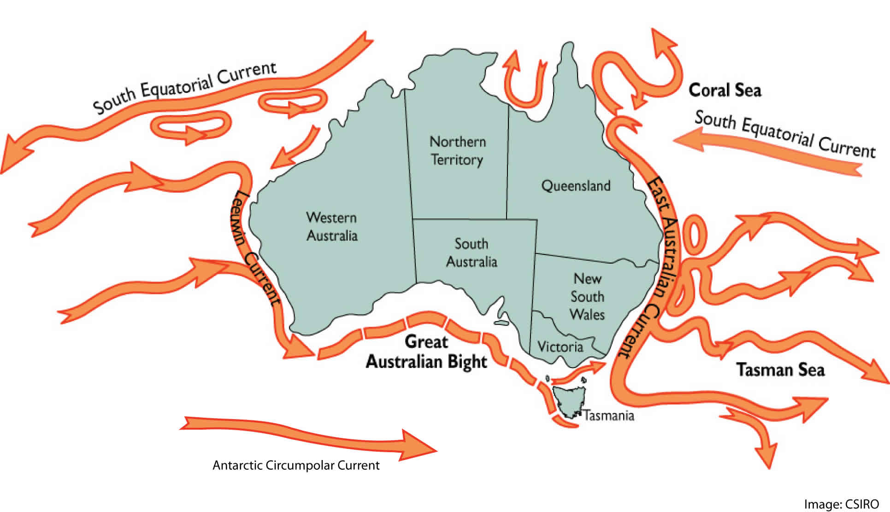

Eventually Marlin and Dory’s exit out of the EAC comes up however, coming off the one exit are 6 smaller exits. Using combinations can you help Marlin and Dory figure out how many two tunnel combinations there are?

Slide 23
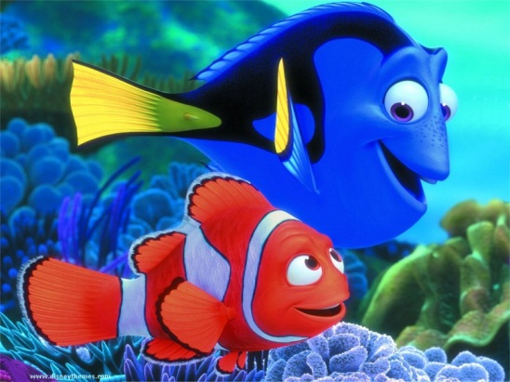

ANSWER:
If there are a total of 6 small exits and they want a combination of two small exits. How many possible combinations can be made?
C(6,2)= 6!/2!(6-2)!
=6!/2!4!
=15
Therefore there are 15 possible combinations of two exits.
Move blue box for answer

Slide 24
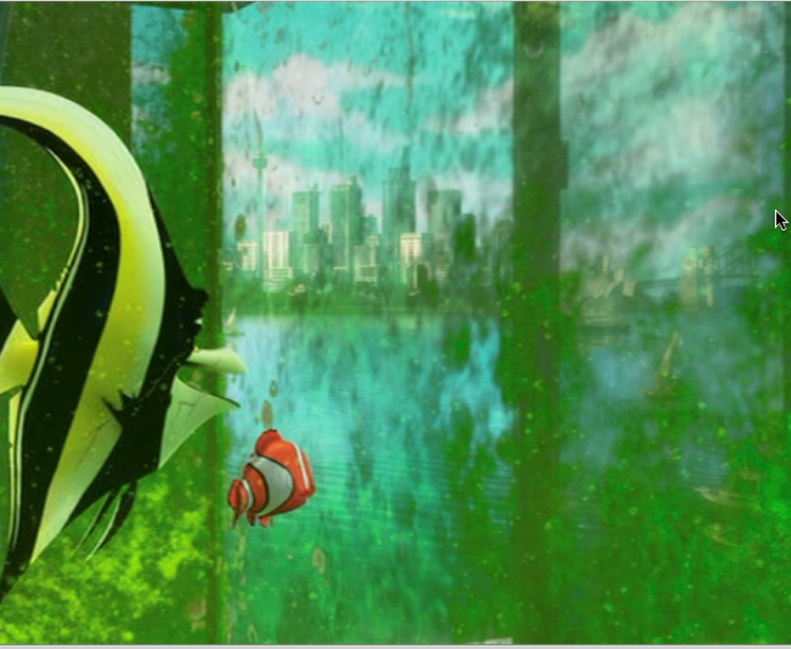
While Marlin and Dory had been fighting against odds to rescue Nemo, Nemo had been taken to a fish tank in a dentists office. He made new friends that vowed to get Nemo out of there and back to his father.
If the dentist cleans the tank twice a week and the first time he cleans it the fish plan their escape, what is the probability that Nemo will escape in a week and what is the complementary event?

Slide 25
ANSWER:
If the tank is only cleaned twice a week and the first time Nemo can’t escape because they are hatching their plan.
A complimentary event is the opposite to the event. In this case it would be what is the probability that Nemo will not escape.
Times he can escape/total opportunities
= ½
Therefore, the probability of Nemo escaping is ½ or 50%.
Times he can’t escape/ total opportunities
= ½
Therefore, the probability that Nemo will not escape is ½ or 50%.
Move blue boxes for answers

Slide 26

Events are the possible outcomes of an experiment or activity. Dependent events are two or more events that are conditionally based on the outcome of each other. The escaping of Nemo is an event and Marlin finding Nemo is an event. Together they are Dependent events.
What is the probability that Nemo will escape and be found by Marlin.

Slide 27
ANSWER:
½
Found
If the probability of Nemo escaping is ½ as decided before, then we need to also figure out what the probability of Nemo being found is.
Since Nemo can either be found or not then there is a ½ or 50% chance that Marlin will find Nemo.
½
Escape
Not found
½
No escape
½
Not found
0
Move blue box for answer
Since Nemo has to escape to be found there is no being found option for if he doesn’t escape. Therefore there is a ½ or 50% chance that Nemo will both escape and be found.

Slide 28
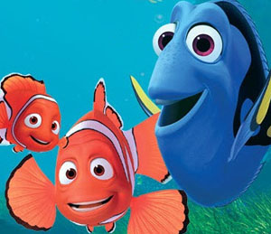
Through luck and fate Nemo and his father Marlin are reunited and both have gained a friend by the name of Dory.
THE END!

