Slide 1
Lady and the Tramp
A Counting Stories Project

Slide 2
A little heads up
Throughout this story you will notice different colours of text appearing. As this is a Counting Stories project, these colours are important and this is the key for these colours:
When you see text in pink, these words or phrases are important terms/concepts/principles/formulas.
When you see text in blue, these numbers/letters/words are equations as part of a solution to the question.
When you see text in green, these numbers are the answers to the questions.

Slide 3
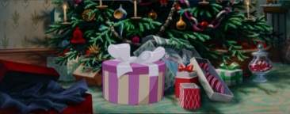
“What a Darling little Lady”
It was Christmas Eve in the Dear household and the tree was just brimming with gifts and this year they were extra special; one of them was a little cocker spaniel puppy! Given that Jim Dear has gotten Darling six gifts and she can only open one of them the night before Christmas, what is the probability that she will open her extra special gift on Christmas Eve?

Slide 4
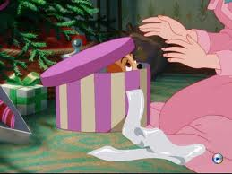
The Probability
As there are six gifts to choose from, and only one of them is the puppy, the probability of this event would be found by taking the number of gifts that are the puppy, in this case 1 and putting it over the number of total gifts, in this case 6.
Therefore, the probability of Darling choosing the puppy as her one Christmas Eve gift is 1/6.

Slide 5
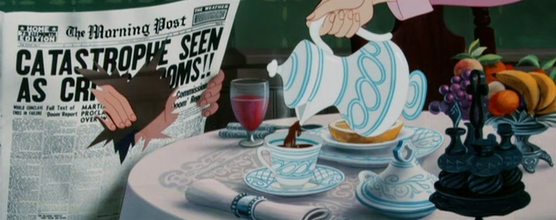
“We See less bad news…”
As Lady grew she was given an exciting task to perform: she was to fetch the newspaper for Jim Dear every morning! Unfortunately, this wasn’t as easy as she’d originally thought. You see, there were seven different newspaper boys for each day of the week and four of those boys had a nasty habit of throwing the newspaper so far that it landed in the bird bath, making it wet and easy to rip when she went in through her doggie door. However, she could get the wet newspaper in without tearing, if it happened to be one of the days Darling left the back kitchen door open while she was cooking; which she did three days a week. What are the chances that Lady gets the newspaper inside without it ripping?

Slide 6
The Probability
Using the multiplicative and additive principles, we can deduce the probability of Lady delivering a rip-free newspaper. But first, we need to figure out how many ways she can get the newspaper in without ripping.
One way is the paper being delivered by one of the three paper boys who are careful.
Another way is the paper being delivered by one of the four careless paper boys but the back kitchen door being open.
First we will find the probability of the first occurrence:
P(1)= # of careful paper boys/# of total paper boys
= 3/7
Second, we will find the probability of the second occurrence by multiplying the two probabilities by each other:
P(2)=p(Careless) x p(Kitchen)
=4/7 x 3/7
=12/49
To find the total probability, we will add the two probabilities together:
P(1or2)=P(1)+P(2)
=12/49 + 3/7
=12/49 + 21/49
=33/49
Therefore, the probability of Lady getting the paper in the house without ripping is 33/49.

Slide 7
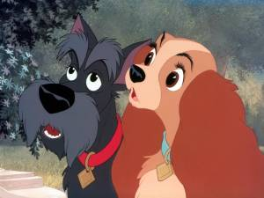
“I got my license”
Lady’s all grown up and she’d got her dog license on a shiny new collar, meaning that she could leave the yard on her own now. Today, she’d decided to go and visit her friend Jacques. However, he had a very strange owner who flipped a coin three times to decide whether he would take his dog for a walk in the park. Two or more tails meant that Jacques would go for a walk. Two or more heads meant that he stayed home. Conduct an experiment of 20 trails that could give the experimental probability that Jacques would be home.

Slide 8
The Probability
Experimental probability is very much an individualized thing as several experiments could bring a wide variety of answers. Here is an example of the experiment with 20 trials:
The experimental probability is deduced by counting the number of times that the event that you want occurs, in this case the number of times two or more heads appears, and putting that over the total number of trials that you did, in this case 20.
Therefore, the experimental probability of Jacques being home using this example is 9/20.
H, T, T
H, H, T
H, T, T
H, T, T
T, H, H
T, T, T
T, T, T
H, H, H
T, H, T
T, T, H
H, T, H
H, H, T
T, T, H
T, H, T
H, H, H
H, H, T
T, H, T
H, T, T
H, H, H
H, H, T

Slide 9
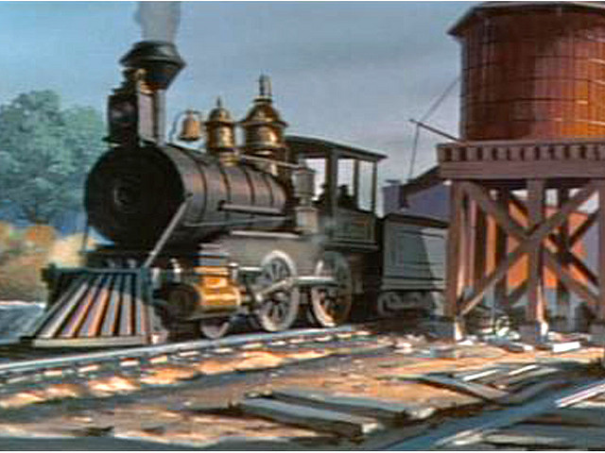
“Choo-Choo!”
Now, Tramp was a stray dog and he made his home in the trainyards just outside of Lady’s town. All day he watched the trains leave the train yard. He knew that there were 24 trains. In one day, 2 of those trains never left the yard, 10 of them went to Sussex, and 4 of them travelled to Sussex and London. However, Tramp knows that there are trains that went just to London and he wanted to figure out how many.

Slide 10
The Solution
In this question, there are both mutually exclusive and non-mutually exclusive events.
The mutually exclusive event would be the 2 trains that never leave the station because they do not coincide with the other trains.
The non-mutually exclusive events are the trains going to Sussex and London because some of the trains go to both.
In order to figure out how many of the trains go just to London, we will use the following formula (make note of the algebraic representations):
T=Total Trains, S=Sussex, L=Just London, SandL=Sussex and London, Y=Yard
T=(S-SandL)+L+SandL+Y
24=(10-4)+L+4+2
24=6+4+2+L
24=12+L
24-12=L
12=L
Therefore, 12 trains go just to London.

Slide 11
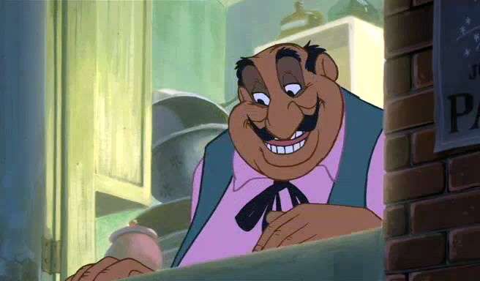
“Breakfast…”
Just behind Tramp’s trainyard, there was a street that featured two of his favourite breakfast joints: The Bakery and Tony’s. The Bakery was only willing to feed Tramp breakfast 3 days a week. Tony’s, however, would feed him breakfast 5 days a week. What is the probability that Tramp will be able to get breakfast from both The Bakery and Tony’s?

Slide 12
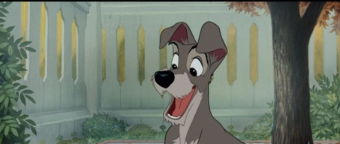
The Probability
Since these are independent events, meaning that they do not rely on eachother to occur. By this standard, we are able to simply use the multiplicative theory to deduce the probability that Tramp will be able to eat from both restaurants:
P(BandT)=P(B) x P(T)
=3/7 x 5/7
=15/49
Therefore, the probability of Tramp being able to eat from both The Bakery and Tony’s is 15/49.

Slide 13
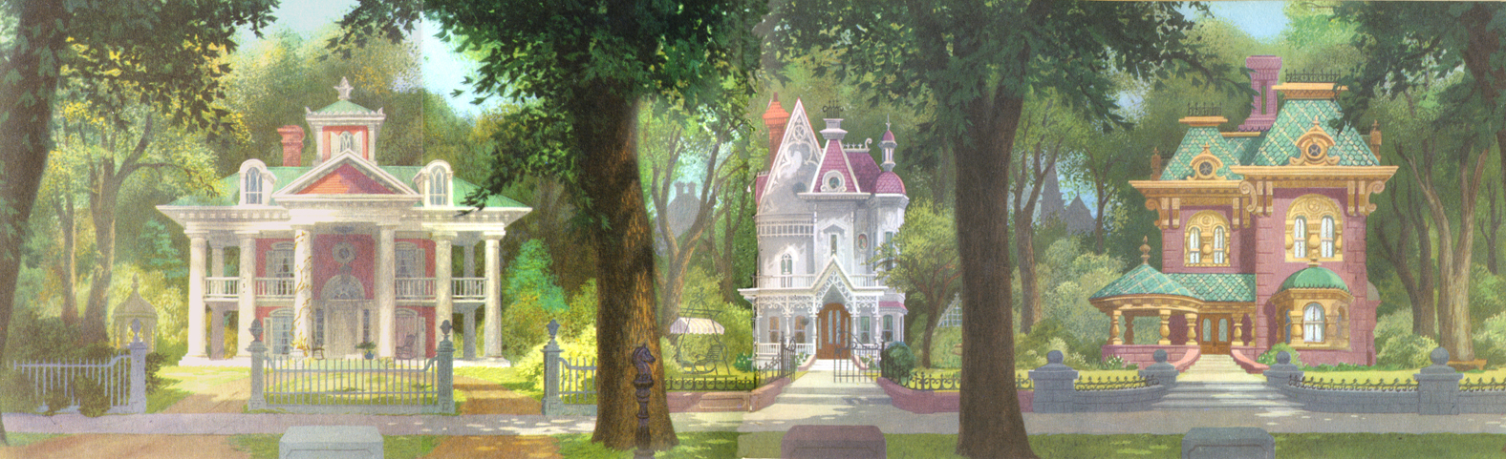
“Wow, what a dame…”
It’s Saturday afternoon and Tramp always goes for a walk in the rich neighbourhood on Saturday afternoons to see the families like the ones he makes up. Every Saturday afternoon he goes to the same little crescent, Lady’s crescent, and spins with his eyes closed. Whichever house his nose is pointing at when he stops, he will check it out. There are 5 houses on the crescent. Given that Lady has a 1/3 chance of being out in her yard on any particular afternoon, depending on how Darling was feeling, what are the chances that Tramp and Lady will meet?

Slide 14
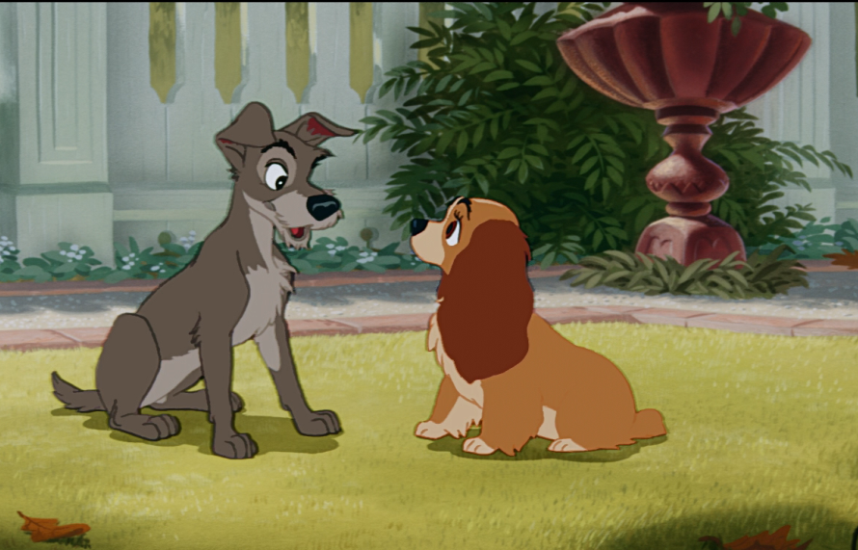
The Probability
We are trying to find the theoretical probability that Lady and Tramp will meet. In order to do this, we will need to use the multiplicative principle again to deduce the probability of Lady being in the yard and Tramp picking her house:
P(YandH)=P(Y) x P(H)
=1/3 x 1/5
=1/15
Therefore, the theoretical probability that Lady and Tramp will meet is 1/15.

Slide 15
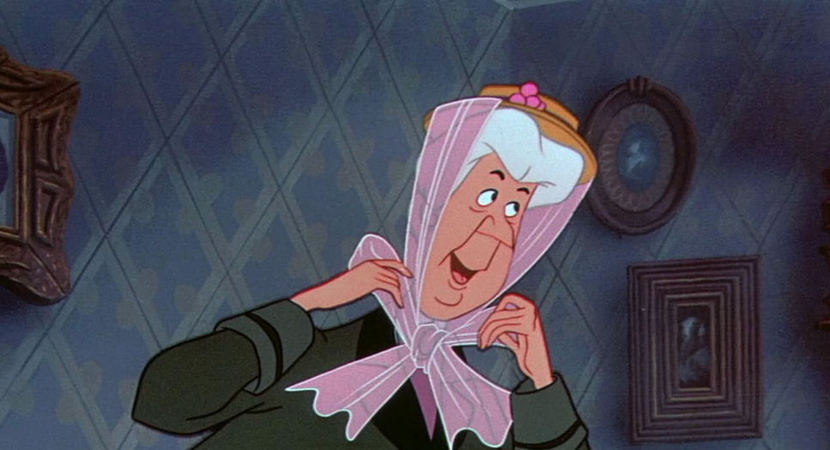
“Aunt Sarah! Aunt Sarah!”
A precious little gift had arrived in the Dear household, a tiny baby boy. Jim and Darling were absolutely thrilled but also exhausted, so Aunt Sarah was kind enough to offer to babysit for the weekend to give them a break. One thing Lady loved about Aunt Sarah is that she always brought homemade dog treats for her. This time, Aunt Sarah brought a tin that has 15 treats in it: 7 brown, 4 blue, and 4 red. If Aunt Sarah is giving Lady two treats what is the probability that Lady will get the outcome of two red ones in a row?

Slide 16
The Probability
This time it’s a little different as we are finding conditional probability because there is a dependant event involved. If one red cookie has already been taken and eaten by Lady, the probability of choosing another red cookie will have changed, because not only is there less cookie, but also one less red cookie specifically. Therefore, this time we will still be using the multiplicative principle, however we will be using the following formula:
P(R1andR2)=P(R1) x P(R2|R1)
The symbol | means “given that”.
P(R1andR2)=P(R1) x P(R2|R1)
=4/15 x 3/14
=12/210
Therefore, the probability of Lady getting two red cookies in a row is 12/210.

Slide 17
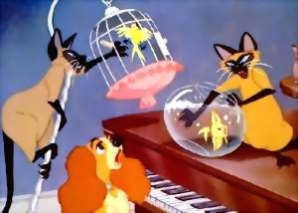
“We are Siamese, if you please…”
Oh, no! Much as Lady loved Aunt Sarah’s amazing dog treats, one thing that she absolutely detested about the woman is that she had two devious and evil Siamese cats who always knocked over things when they visited. Not only did they do that, but then they made it look like her fault and it looked like Aunt Sarah had brought them along for the visit. If there are 9 things in the living room that they could possibly knock over and they can only knock over 6 before Aunt Sarah will come to investigate, how many possible ordered arrangements could there be in their mad dash to cause a ruckus?

Slide 18
The solution
A simpler way of referring to these ordered arrangements is to call them permutations and the formula for these is defined by:
P(n,r)=n!/(n-r)!
P: permutations, n: total # of items, r: # of items being arranged.
The symbol ! means “factorial”, a function that should be available on your calculator, or else is the product of all positive integers less than or equal to n.
We will use this formula, given that n=9 and r=6
P(n,r)=n!/(n-r)!
=9!/(9-6)!
=362 880/3!
=362 880/6
=60 480
Therefore there are 60 480 different possible permutations of the items in the living room that the cats, Si and Am, could destroy.

Slide 19
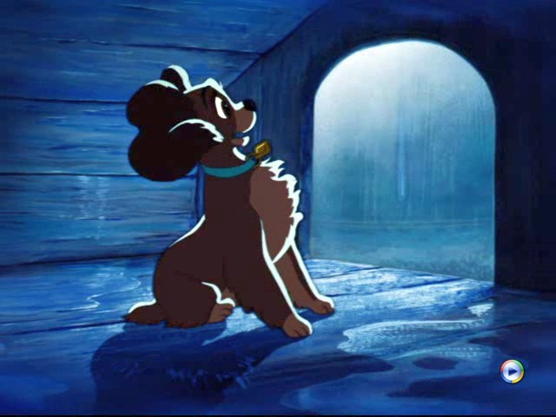
“Bad dog!”
Drat! Just as Lady knew it would happen, Si and Am destroyed the living room and blamed it on her. Now, Lady was certain that Aunt Sarah hated her exclaiming, “Bad dog!” over and over as she threw Lady out in the yard. She just knew that Jim and Darling would be so disappointed in her when they returned and they wouldn’t want her, so she decided to run away.

Slide 20
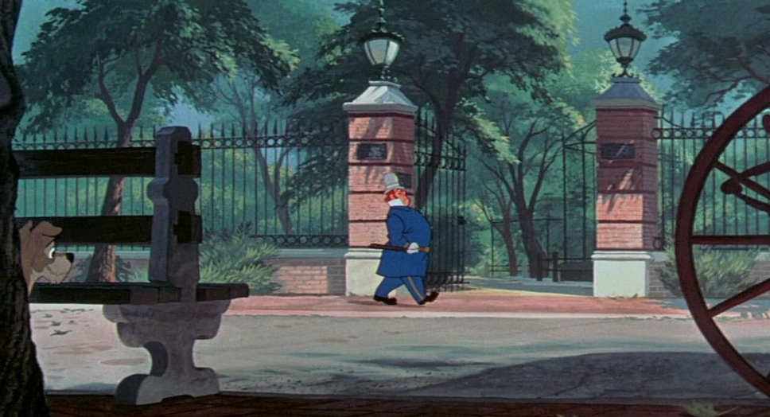
“Hey Pidge!”
Soon, Lady caught up with Tramp on the street. She was very glad to see a familiar face and Tramp was pretty glad to see his newest fascination, “Pidgin”, as he nicknamed her. Lady told him all about the terrible things that happened at home and Tramp decided to take her to the zoo to take her mind off of it. If there are 17 different exhibits at the zoo, how many ways can the order of their browsing vary if their first exhibit is the hyenas and they finish with the beaver?

Slide 21
The solution
This question is also dealing with permutations. However, this permutation has stipulations. The wonderful thing about permutations is that when guidelines are placed on the order of the items, or in this case the exhibits they are visiting, you can just subtract them from the total amount of exhibits to get your total. So, if there are 17 exhibits and we have two that already have their order, we only need the permutation of 15.
We will use the permutations formula, given that n=15 and r=15:
P(n,r)=n!/(n-r)!
=15!/(15-15)!
=15!/1
=15!
=1 307 674 368 000
Therefore, there are 1 307 674 368 000 varying ways to their browsing.

Slide 22
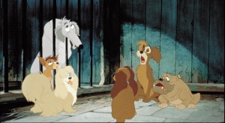
“He’s a Tramp”
Lady and Tramp spent the whole day together and she was beginning to feel like she could be falling in love with this charming mutt when--uh oh! Lady got caught by the dog catcher running around with Tramp. She was taken to the pound and put in a cage with a group of other friendly dogs. Unfortunately, she had to hear about Tramp’s various female escapades from one of his many exes, Peggy. There were 7 of his exes in the pound at that time: 2 spaniels, 3 labs, 1 Chihuahua, and 2 poodles. Those girls were thinking of making a singing trio called the, “Lovesick Puppies”. How many ways can this group be formed if only one spaniel, must be a member of the group?

Slide 23
The solution
This question may seem slightly similar to the other permutations questions, but it’s different because order is no longer important here. This type of question refers to combinations. A combination refers to a set of distinct objects (n) taken at a time (r), without repetition, as an r-element subset of the set of n objects. The formula is as follows:
C(n,r)=n!/r!(n-r)!
Also adding on the multiplicative principle, we can solve this problem:
n(1S and 2O)=(2!/1!(2-1)!) x (5!/2!(5-2)!)
=(2!/1!1!) x (5!/2!3!)
=2 x 10
=20
Therefore, there are 20 different combinations of groups.

Slide 24
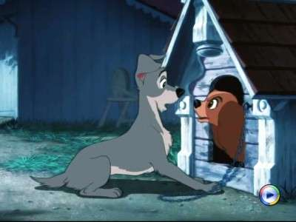
“I’m So Sorry, Pidge!”
Eventually, Lady’s license was able to be processed and they called the house immediately. Aunt Sarah rushed over to the pound to retrieve poor Lady, having been worried sick about her all day. Once home, Lady retreated to her doghouse for some solitude when suddenly, Tramp showed up, eager to apologize. However, Lady was hearing nothing of it, after learning all about his other girlfriends, whether they be ex- or not, and she sent him on his way.

Slide 25
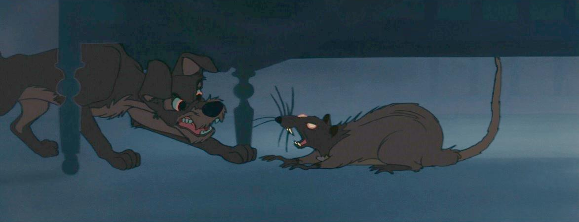
“In the Baby’s Room!”
Very soon after Tramp left, his tail between his legs, Lady spotted a rat in the yard. She began to growl and yip at it, attempting to keep it away from the house and the baby because rats carry diseases. The rat began to skirt it’s way across the yard and towards the house, specifically towards the babies room and Lady, in her mad attempt to stop it, got her neck accidentally stuck in her chain, immobilizing her. She began to call furiously for Tramp to come back and he did as fast as he could. She barked at him to save the baby while she worked on freeing herself and that’s exactly what he did. Just as he finished killing the rat, Aunt Sarah rushed in, hearing the growls and the baby’s cries, catching Tramp in a very negative-looking situation, thinking him a stray dog attacking the baby. She called the pound to come and take him away.

Slide 26

“Deal With This One Immediately.”
Just as the pound collected Tramp, Jim and Darling arrived home to all the commotion. Asking the dog catcher about the ruckus, they heard news to make them believe that Tramp attacked the baby and so they flew upstairs to check on Junior. Seeing that he was fine, they were confused but Lady just then freed herself from her chain and bolted up the stairs to reveal the dead rat in the corner. Everyone was shocked and soon realized that Tramp had actually saved the baby and that they had to rescue him from his own fate at the pound. There are 3 blocks from the Dear house to the pound. Not knowing where the dog catcher’s truck went right or left, what are the chances that Jim, Darling, and Lady can catch it in time to save him?

Slide 27
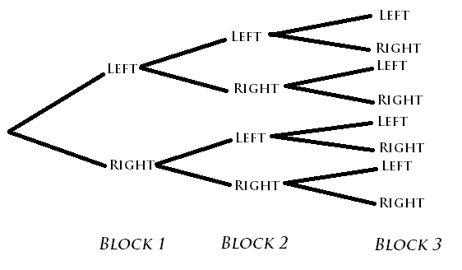
The Chances
The directions to the pound are right, left, right. What is the probability of the Dears picking the correct path?
There is only 1 path that follows right, left, right and so that will be our numerator.
There 8 possible outcomes at the end of the blocks and so that will be our denominator.
Therefore, the chances of Dears picking the correct path is 1/8.

Slide 28
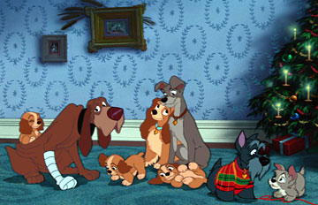
“Smile!”
The Dears did end up making that 1/8 chance and saving Tramp, who became a part of the family himself. Lady and the Tramp fell madly in love and had four puppies, three girls and one boy. Jacques and their friend Trusty, who had actually stopped the dog catcher’s truck at the expense of his own paw, became just as much family as anybody else. Aunt Sarah never jumped to crazy conclusions again and never brought Si and Am back to the Dear house. And they all lived happily ever after.

Slide 29
The End

